Slide 1
Topic 49 - Language identification
Stoicescu Adrian-Nicolae and Tantaru Dragos Constantin

Slide 2
Introduction
This project addresses the challenging task of distinguishing between the Romanian and Moldovan dialects within textual datasets.
Our research focuses on the development and comparison of various supervised learning approaches to enhance the accuracy of dialect identification.
We detail the methodology, experiments, and comparative analysis of the employed supervised learning models, highlighting their strengths, limitations, and potential areas for further research.

Slide 3
Dataset

Slide 4
Dataset
The MOROCO (Moldavian and Romanian Dialectal Corpus) dataset is a specialized corpus created for analyzing and distinguishing Romanian and Moldavian dialects.
The dataset contains 31,564 text samples, evenly divided across six categories: culture, money, politics, science, sports, and technology. The samples are separated into two subsets: training (21,719 samples) and testing (5,924 samples).

Slide 5
Feature extraction
For feature extraction from the sentences and generating feature vectors, we implemented two distinct methods. We additionally also used a finetuned LLM for the dialect task.
Among the most common term-weighting techniques used nowadays is TF-IDF. According to a 2015 survey, TF-IDF is used by 83% of text-based recommendation systems in digital libraries.
We also used text embeddings to extract characteristics from textual data using neural models all of them available through Hugging Face.

Slide 6
Machine learning models

Slide 7
SVC (Support Vector Classifier)
This is a supervised machine-learning model that can handle binary classification as well as multi-class classification tasks. An SVM model was demonstrated to generalize very effectively on its training data while maintaining the same accuracy for inference on new data given into the model.
They provide two key advantages over modern methods, such as neural networks: increased speed and efficiency while dealing with smaller datasets (in the hundreds). This makes it ideal for cases involving little data, allowing for successful analysis and categorization even with lower sample numbers.

Slide 8
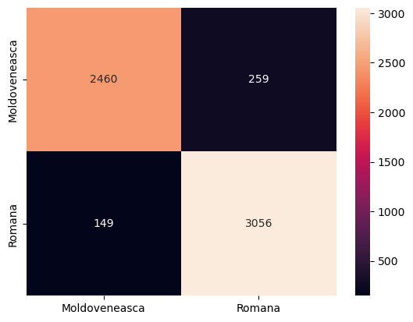
SVC (Support Vector Classifier)
First task
Accuracy: 0.931
F1 Score: 0.930

Slide 9
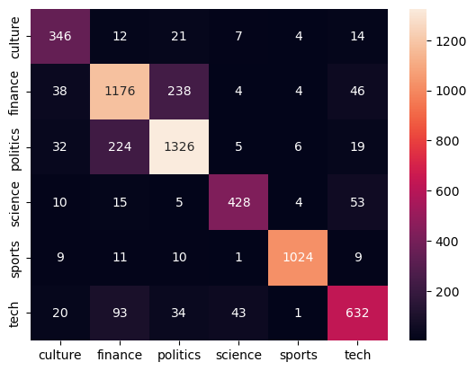
SVC (Support Vector Classifier)
Second task
Accuracy: 0.832
F1 Score: 0.835

Slide 10
K-Neighbors Classifier
The K-Neighbors Classifier belongs to the instance-based or "lazy" learning algorithm category. This technique is based on the idea that similar instances cluster together in the data space.
This method is particularly effective for problems where the decision boundary is irregular, as it can adapt to the local structure of the data.

Slide 11

K-Neighbors Classifier
First task
Accuracy: 0.93
F1 Score: 0.93

Slide 12
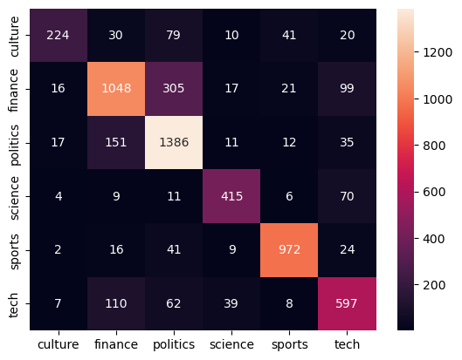
K-Neighbors Classifier
Second task
Accuracy: 0.783
F1 Score: 0.772

Slide 13
Logistic Regression
Logistic regression calculates weighted sums of input features and applies the logistic function to these sums, providing the probability that a given input belongs to a particular class.
Despite its simplicity, logistic regression can achieve high accuracy in language classification tasks, especially when combined with proper feature engineering and preprocessing techniques.
Offers a straightforward and computationally efficient approach, making it ideal for high-dimensional datasets like text.

Slide 14

Logistic Regression
First task
Accuracy: 0.930
F1 Score: 0.929

Slide 15
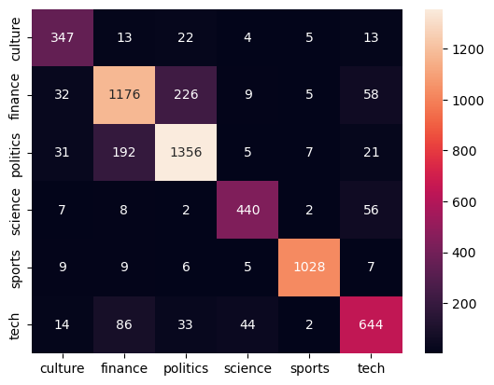
Logistic Regression
Second task
Accuracy: 0.842
F1 Score: 0.844

Slide 16
Mistral
Mistral is one of the best performing LLMs in the 7B parameter class.
We used instruction tuning to finetune a model for the dialect identification task.
Due to large computational demands, we employed a large array of optimizations, like unsloth, Flash Attention, and Low Rank Adaptors.
We also trained some classifiers using Mistral embeddings.

Slide 17
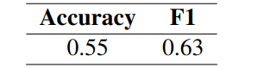
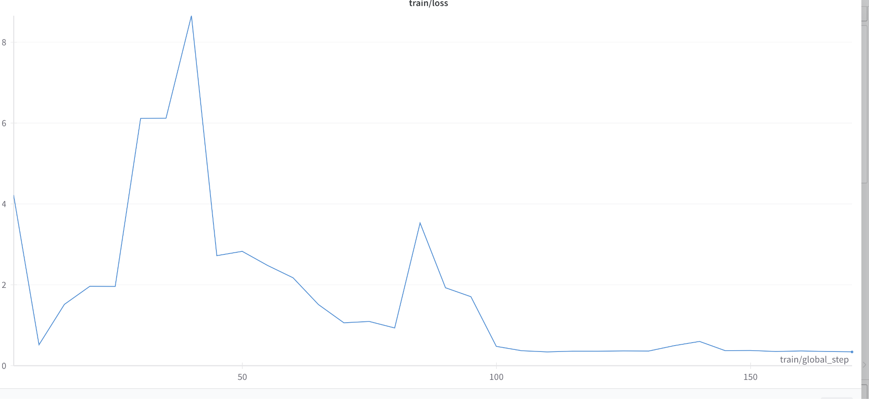
Mistral raw classification
Poor results when using raw extracted text, likely due to Romanian being a low resource language.
Hard to train, convergence was very noisy.

Slide 18
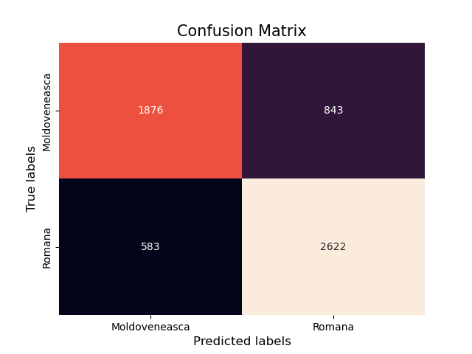
Mistral embeddings
First task
Accuracy: 0.78
F1 Score: 0.8

Slide 19
Conclusion

Slide 20
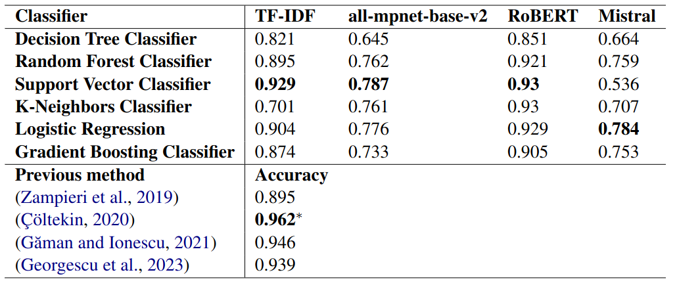
Task 1 Final Results

Slide 21
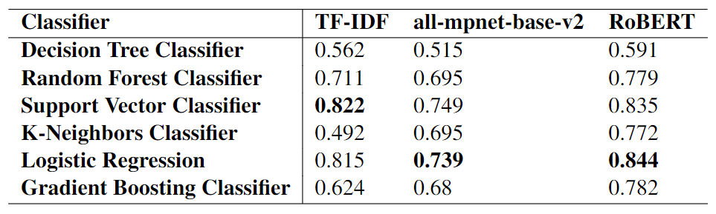
Task 2 Final Results

Slide 22
Conclusion
From our results, it seems that, while there isn't a significant difference between the classical and deep features in terms of the greatest performance, the BERT embeddings might have a greater degree of robustness, as they have overall higher separability than the TF-IDF embeddings, when looking at the scores across many different classifiers. Mistral embeddings seem to be somewhat worse than either of them, while also having the highest degree of variance between classifiers.
Comparatively, since Romanian is presumably a low-resource language for the Mistral model's corpus, the performance obtained using it is significantly lower than the other approaches. We hypothesize that using a base model with a much larger Romanian pretraining corpus could lead to a significant improvement.

Slide 23

Bibliography
Andrei M. Butnaru, Radu Tudor Ionescu. MOROCO: The Moldavian and Romanian Dialectal Corpus. ArXiv, 2019: https://arxiv.org/abs/1901.06543
Hastie, Trevor. (2001). The elements of statistical learning : data mining, inference, and prediction : with 200 full-color illustrations. Tibshirani, Robert., Friedman, J. H. (Jerome H.). New York: Springer. ISBN 0-387-95284-5. OCLC 46809224

Slide 24
Thank you!

